Slide 1
Question 223.2.1
For a wave to exist, you need the following
Source of disturbance, a medium, and a connection between medium elements
A fluid, an energy source, and distance
A liquid, a disturbance, and a transfer of energy
A really good touchdown that gets the crowd excited

Slide 2
Question 223.2.2
What is the medium for an ocean wave?…
The electromagnetic field
Air molecules
Free space
Water molecules

Slide 3
Question 223.2.3
Is an ocean wave …
Transverse
Longitudinal
A combination of transverse and longitudinal

Slide 4
Question 223.2.4
At a football game, “the wave” might circulate through the stands and move around the stadium. In this wave motion, people stand up and sit down as the wave passes. What type of wave would this be characterized as?
polarized wave
a) longitudinal wave
b) lateral wave
c) transverse wave
d) soliton wave
e) Cougar wave

Slide 5
Transverse Wave
Longitudinal Wave

Slide 6
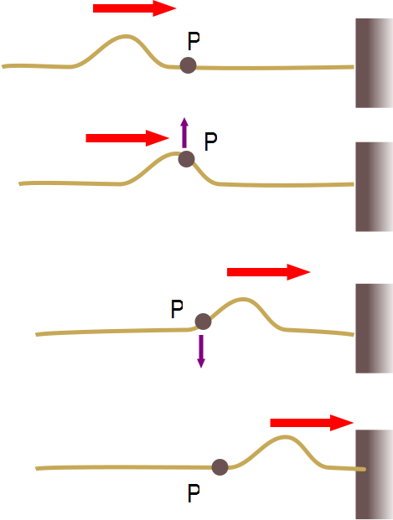

Slide 7
Question 223.2.5
In an ocean wave, what would be the most likely path a single particle traverses as the wave moves by?
B
A
C

Slide 8
Question
Suppose I have a uniform metal rod that has a length of 2.0m and a mass of 200.0kg. If I saw off 0.20m of this rod, how much mass would the piece have?
20kg
40kg
100kg
0kg

Slide 9
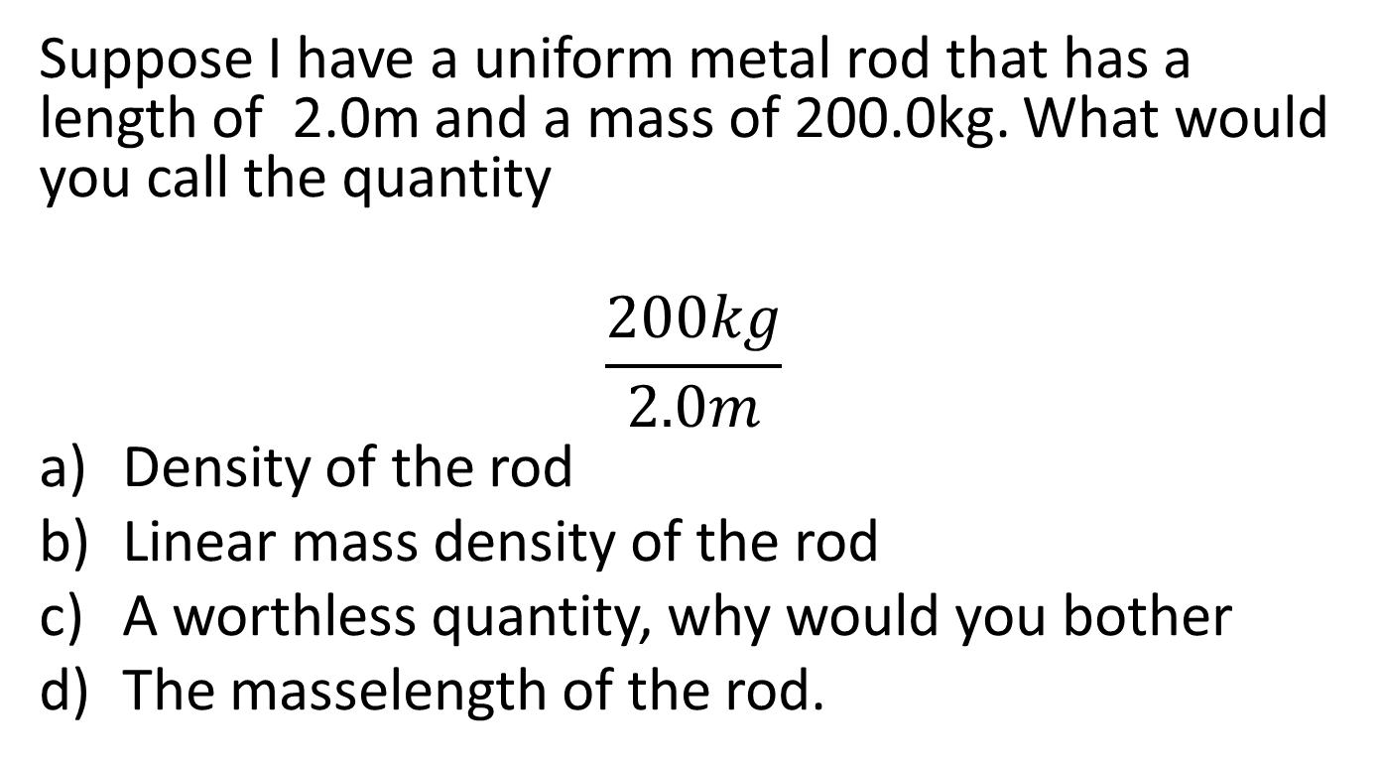
Question
Suppose I have a uniform metal rod that has a length of 2.0m and a mass of 200.0kg. What would you call the quantity
$$\frac{200kg}{2.0m}$$
Density of the rod
Linear mass density of the rod
A worthless quantity, why would you bother
The masselength of the rod.

Slide 10
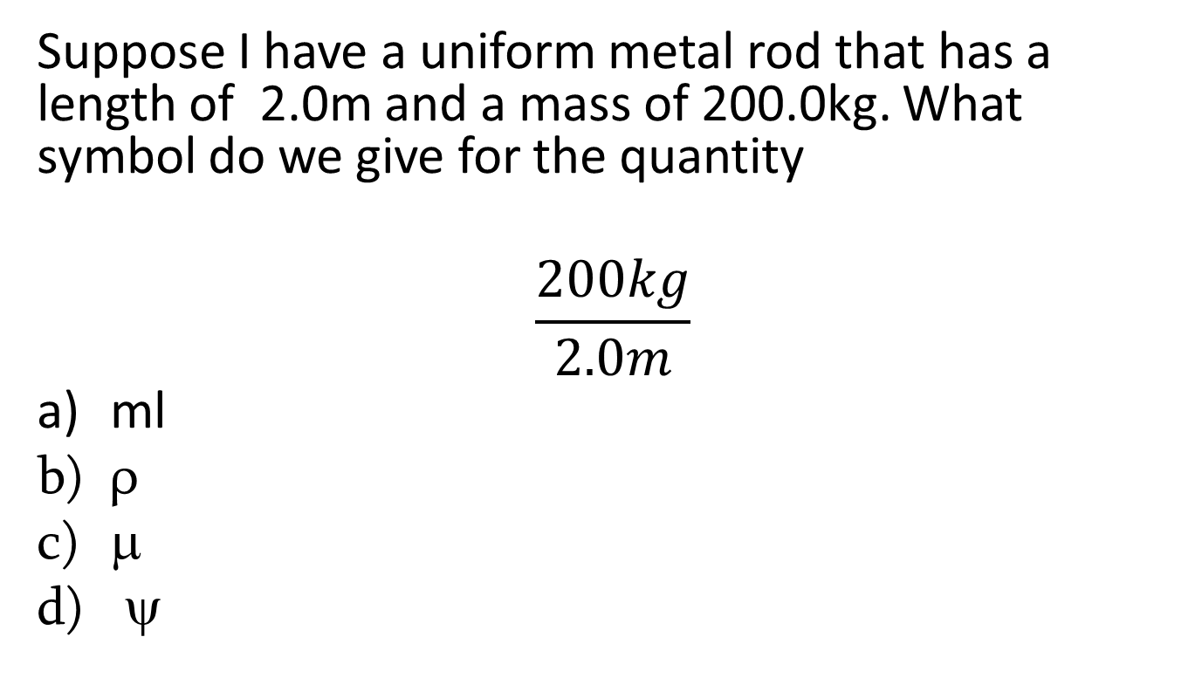
Question
Suppose I have a uniform metal rod that has a length of 2.0m and a mass of 200.0kg. What symbol do we give for the quantity
$$\frac{200kg}{2.0m}$$
ml
ρ
μ
ψ

Slide 11
Question 223.2.6
We learned that the speed of waves on strings is given by
Will this equation work for a wave traveling along a large vertically hanging chain?
Yes, this is a general formula
No, because chains are not strings
No, because the tension along the chain varies
No, because tension is unique to ropes and strings, and really chains experience normal forces between the links.

Slide 12
Question 223.2.7
Does a wave on a string move faster for a heavier or lighter rope?
Heavier
lighter

Slide 13
Question 223.2.7.5
A wave is traveling on a rope. Does the wave speed increase or decrease as you pull harder on a rope
Increase
Decrease

Slide 15
Before
9
After
9

Slide 17
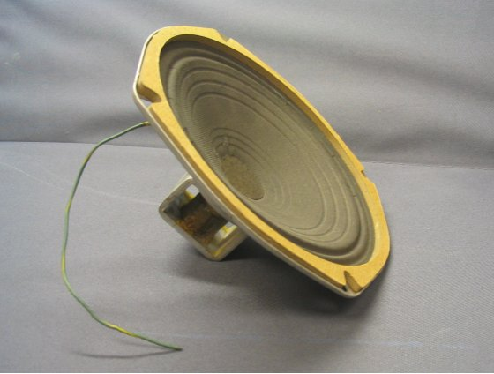

Slide 19
Question 7.5
For sound waves in air, something experiences simple harmonic motion, what is it?
A pipe
The air particles
The pressure
dust

Slide 20
Bar Graph of Displacement from Original Position

Slide 24
Question 223.2.8.1
S
x
In the displacement graph for a sound wave shown above. What does the light green bar represent?
The particle that was at this position has moved to the left
The particle that was at this position has moved to the right
The particle that was once where the pink bar is has moved to where the light green bar is
The particle that was once where the blue bar is has moved to where the light green bar is

Slide 25
Question 223.2.8.2
S
x₁
x_{P}
x₂
x
P
In the displacement graph for a sound wave shown above. What does the displacement, s, at point P represent?
The particle that was at x_{P} has moved to the left
The particle that was at x_{P} has moved to the right
The particle that was once at x₁ has moved to x_{P}
The particle that was once at x₂ has moved to x_{P}

Slide 26
Question 233.2.8.5
What is the energy transfer mechanism for sound waves?
Elastic forces between molecules
Pressure forces between molecules
Electrical forces between molecules
Collisions between molecules

Slide 27
Question 223.2.9
We found that the equation
Gave a pulse that moved to the right with velocity v
What will the following equation give
A pulse that moves to the right (it is the same equation)
A pulse that moves to the left
This gives a non-real result and is not a pulse
A pulse that moves in the +y direction

Slide 31
Question 223.2.10
y
A
A traveling wave is shown below moving to the right at 1m/s in a snapshot view. What might the history graph look like for the position x=0?
time
y
B
time
y
C
x
time

Slide 32
y
t₁
x₁
x
y
t₂
y
x₁
x
y
x₁
t₃
t₁
t₂
t₃
t₄
time
x₁
x
y
t₄
x₁
x

